Slide 1
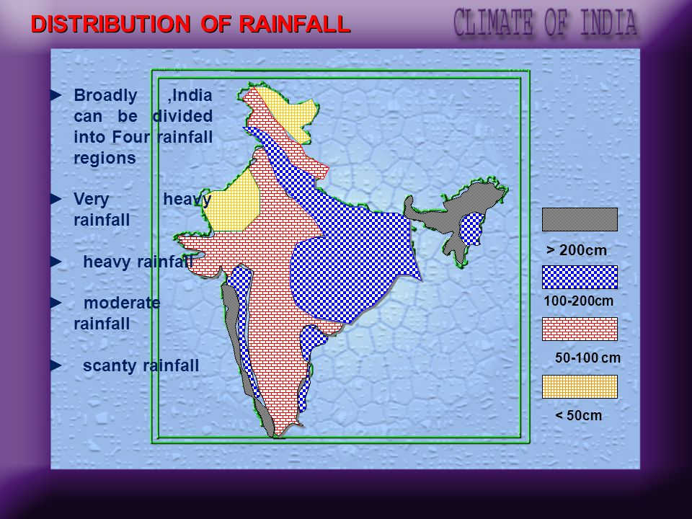

Slide 2
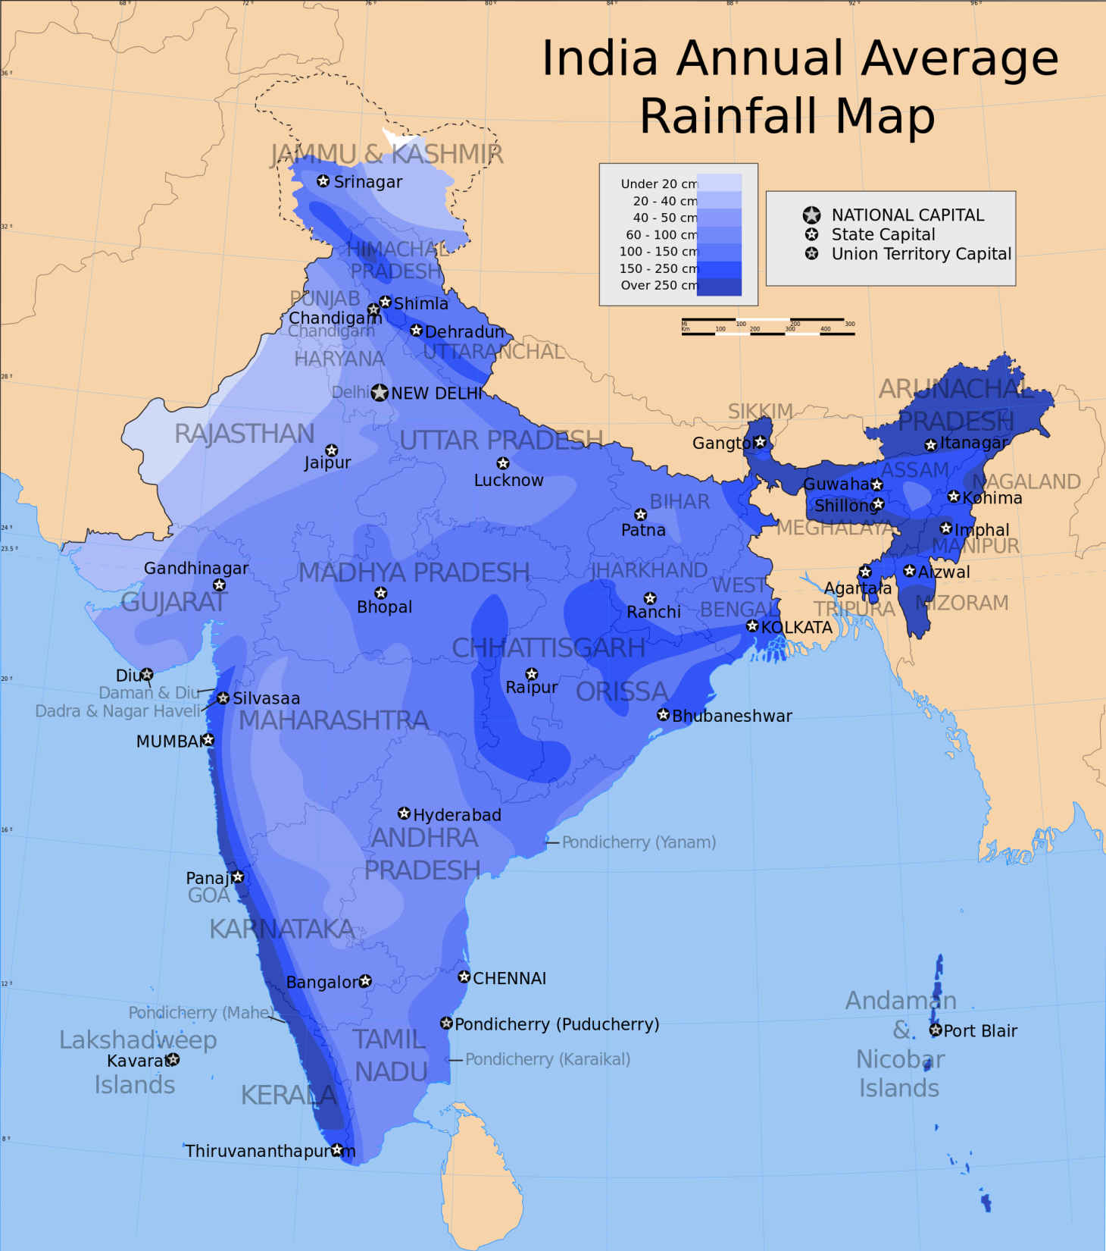

Slide 3
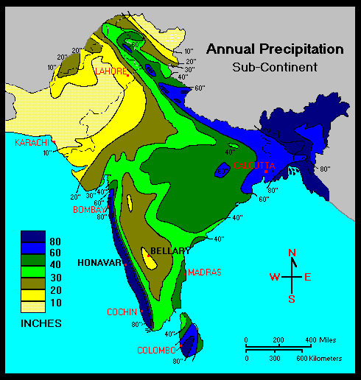

Slide 4
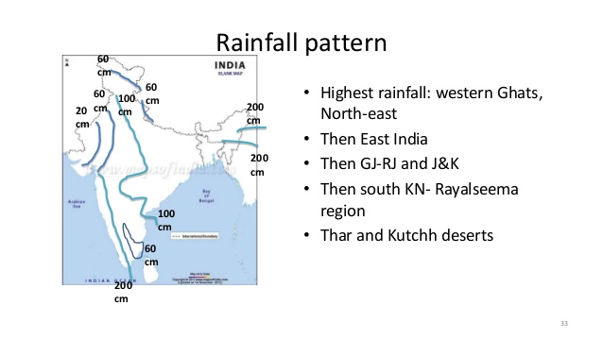

Slide 5
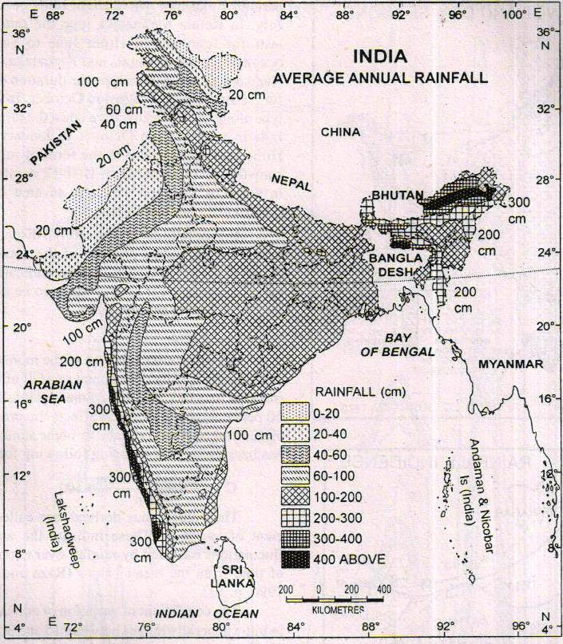

Slide 6
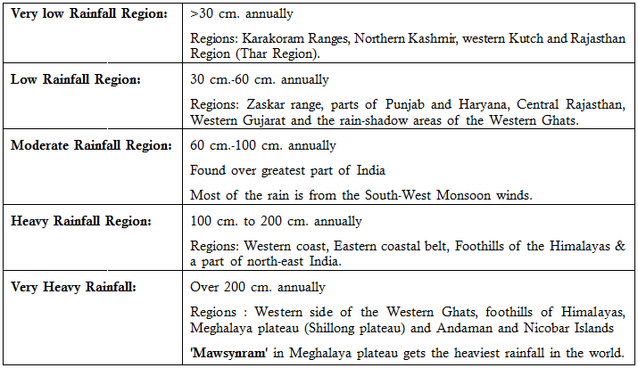

Slide 7
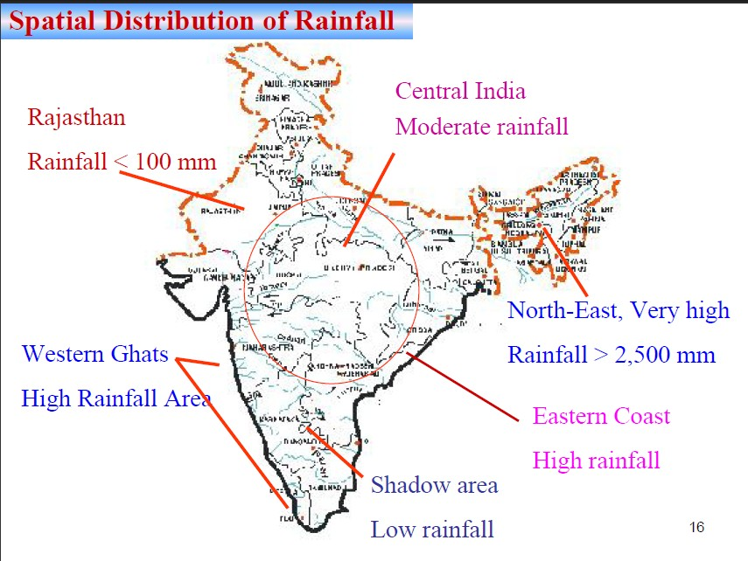

Slide 8
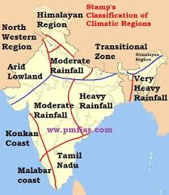

Slide 9
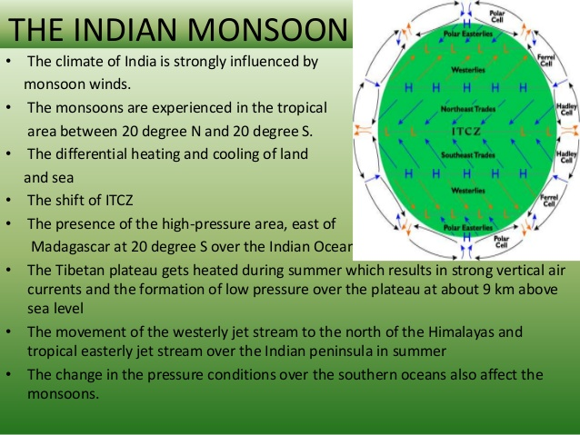
Climate of india

Slide 10
Climate of India tropical monsoon type
      Per humid north east climate
      Humid west coast climate
      Humid south east climate
      Sub humid transition climate
      Sub humid littorals climate
      Sub humid continental climate
      Semi arid sub tropical climate
      Semi arid tropical climate
      Arid climate
      Mountain climate

Slide 11
